Slide 1
Why you don't test queries with variables
Nina Weisheidinger / March 2021
Notes:
Hello everybody,
Today I want to welcome you to my session on Why you don‘t test queries with Variables

Slide 2

About Me
Nina Weisheidinger Senior Consultant Devoteam Alegri GmbH
Java with SQL Server 7.0/2000 as Data Source
SQL Server DataWarehouse since 2009
nina.weisheidinger@devoteam-alegri.eu
Twitter: @DataNina2 www.devoteam-alegri.de
Notes:
First of all I want to introduce myself.
My name is Nina Weisheidinger and I‘ve been working as a Senior Consultant for Devoteam Alegri since 2017.
If questions come up during my session please write them in the chat and we will get back to them in the queston part at the end of my session.
Now after introducing myself I will turn off my camera to save band width.
Let‘s start with the session

Slide 3
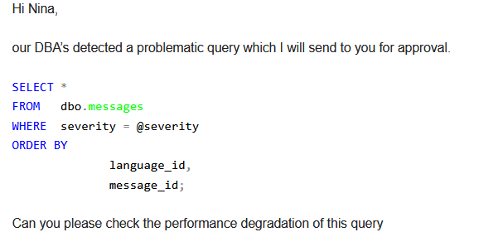
Basic Situation
Notes:
Initially, I would like to explain the basic situation to you.
A couple of days ago I’ve received this email from our operation team, asking me to look into the problem.
I’ll show you what I did
Why this is happening and why it is a problem I will show you today

Slide 4
Agenda
1 Query Execution and Process Life Cycle
2 Elements of Statistics
3 Solutions despite the use of variables?
4 Questions

Slide 5
1
Query Execution and Process Life Cycle

Slide 6
Query Execution and Process Life Cycle
Parse
Syntax Check
Syntax Normalization or Standardization
Compile
Variable declaration and assignment
Execution of IF-ELSE statements, WHILE loops, CURSOR etc.
Optimize
Determination of the best execution plan for the query using
Indexes
statistics
Execute
Convertion of the execution plan into operations for the database
Return of the results
Notes:
Parsing
Syntax Check
sql statement is incorrect then it throws an error message otherwise it goes to next step.
We can parse a sql query without compiling or executing it The setting of SET PARSEONLY or in the SSMS
Syntax Normalization or Standardization
check the existence of database objects like tables, views etc
Examples queries standardization:
a. Qualifying the database tables with schema and database name.
b. Replace the * by actual column name. For example:
c. Add indentifer quote ([]) in the all database objects like tables, columns, schema, database etc.
f. Syntax optimization
In this phase syntax of queries are also optimized. For example, it modifies the order of predicates in the WHERE clause, ON clause, HAVING clause etc. It also modifies join order of tables in the JOIN statement.
QUERY COMPILATION
In this phase Transact sql language statement are executed. For examples:
a. Variable declaration and assignment
b. Execution of IF-ELSE statements, WHILE loops, CURSOR etc.
The compilation process is the essential part BEFORE the optimization. A compilation always takes place on the level of a statement, not for the entire batch!
Optimize
try to generate best execution plan based on the cost of different resources (disk, memory etc) used by the query during the execution. Execution plans are dependent upon user created objects:
a. Statistics
b. Indexes
It also dependent on table definition and data constraints, query hints, hardware etc.
EXECUTE

Slide 7
2
Elements of Statistics

Slide 8
Elements of Statistics
Density Vector
Density is the ratio of unique values within the given column or a set of columns
Formula: 1/Number of distinct values for a column or set of column
The higher the density, the lower the selectivity
Histogram
Measures the frequency of which a value occurs within a data set (data distribution)
Can only be used if the value to be searched is known to the query processor at the time of compilation!
Notes:
In our daily life, we use the statistics to take the decision.
In the same way SQL server optimizer use the statistics to choose the right query plan. if the statistics are wrong or outdated , SQL server might choose a wrong query plan.
Microsoft SQL Server provides two areas in the statistics for determining expected data volumes.
The idea behind the histogram is to store the data distribution of a column in a very efficient, compact way.

Slide 9
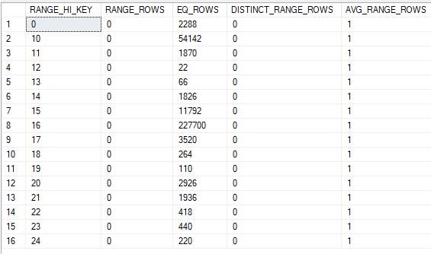
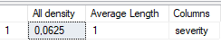
Use of the Density Vector
Histogram
DECLARE @severity TINYINT = 12
SELECT
[message_id]
, [language_id]
, [severity]
, [is_event_logged]
, [text]
FROM
dbo.messages
WHERE
severity = @severity
ORDER BY
language_id
, message_id;
GO
?
Density Vector
Notes:
The workflow shown illustrates the problem with using variables in a command batch.
The second command line uses "a" variable @severity, which was initialized before.
However, in the compile phase, Microsoft SQL Server considers the statement in isolation, and hence during compilation, Microsoft SQL Server does not know what value the variable will occupy at runtime.
Since there is no value for the variable, Microsoft SQL Server cannot access the histogram - so what value should Microsoft SQL Server look for? Instead, the Density Vector must be used as an alternative.
The query uses only the severity attribute as a predicate. For this predicate, a distribution density of 1/16 = 0.0625 is calculated.
This density is multiplied by the number of records present (approximately 309540) and the result is the estimated records for the output.

Slide 10
Use of the Histogram
Histogram
SELECT
[message_id]
, [language_id]
, [severity]
, [is_event_logged]
, [text]
FROM
dbo.messages
WHERE
severity = 12
ORDER BY
language_id
, message_id;
GO
?
Density Vector
Notes:
Since Microsoft SQL Server now knows how many records need to be returned to the client, more precise planning can be assumed when creating the execution plan.
This is reflected - in addition to a more optimal strategy - in the calculation of the resources to be used.

Slide 11
3
Solutions despite the use of variables?

Slide 12
Solutions despite the use of variables?
sp_executesql
sp_executesql [ @stmt = ] statement
[
{ , [ @params = ] N'@parameter_name data_type [ OUT | OUTPUT ][ ,...n ]' }
{ , [ @param1 = ] 'value1' [ ,...n ] }
]
variables are not passed until sp_executesql is compiled
OPTION (RECOMPILE);
a new, temporary plan is generated and immediately discarded after the query completes execution.
The generated query plan doesn't replace a plan stored in cache
Notes:
The variable is not passed until sp_executesql is compiled. This allows Microsoft SQL Server to "sniff" the value and use it in the compile phase.
The value is known and Microsoft SQL Server can access the histogram. But CAUTION is advised here - with sp_executesql we create other problems for ourselves, which may be more serious: Parameter Sniffing
For testing an SQL statement using variables, it would be recommended to recompile the query each time using RECOMPILE. Then the parameter will always be read correctly.

Slide 13
any questions? contact me.
Nina Weisheidinger
nina.weisheidinger@devoteam-alegri.eu

